Slide 1
Standard: SS6E1 The student will analyze different economic systems. a. Compare how traditional, command, and market economies answer the economic questions of
(1) what to produce, (2) how to produce, and (3) for whom to produce. b. Explain how most countries have a mixed economy located on a continuum between pure market and pure command. c. Compare and contrast the basic types of economic systems found in Canada, Cuba, and Brazil.

Slide 2
Economics
How many basic types of economic systems are there? 3
Name the economic systems. Traditional, Command, Market
Which economic system do most textbooks say is the most common throughout the world? Mixed. The GCEE states that mixed is not an economic system but rather a blending of two different types of systems located on the continuum.

Slide 3
Economic Continuum
A group of financial experts set up a rating system to help us understand how much command and market each country has in it.
This Index of Economic Freedom gives each country a number that can be plotted on a economic continuum.
The United States has an Economic Freedom number of 77.6. Since this number is closer to the market side of the continuum, we label the U.S. as a Market Economy.
Now, lets compare the economies of Brazil, Canada, and Cuba!

Slide 4


Economic
Systems
Canada
81%
Brazil
57%
Cuba
28%
0
100
Pure
Command
Pure
Market
Mixed Economy
Notes:
6th Grade- This information is meant to be used in conjunction with the 6th and 7th grade Teacher Notes. For additional resources, go to GeorgiaStandards.org. (Note: This is not an expectation for students to memorize numbers, but to understand that factors that influence specific countries to move more towards a command or market economy). The numbering system is based on The Heritage Foundation’s Economic Freedom Index 2009 The Heritage Foundation is a conservative organization that has partnered with the Wall Street Journal for over a decade to evaluate each country based on a set of 10 criteria to determine economic freedom. Update information using resources listed in the Teacher Notes.

Slide 5
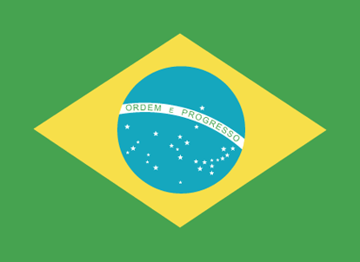
Federative Republic of Brazil

Slide 6

How does Brazil answer the
3 Economic Questions?
What to Produce?
  Businesses decide and government approves/denies it
How to produce it?
  Businesses decide & government regulates procedures
For whom to produce?
  Businesses decide based on supply & demand (price)
Which economic system does Brazil have?
Market

Slide 7
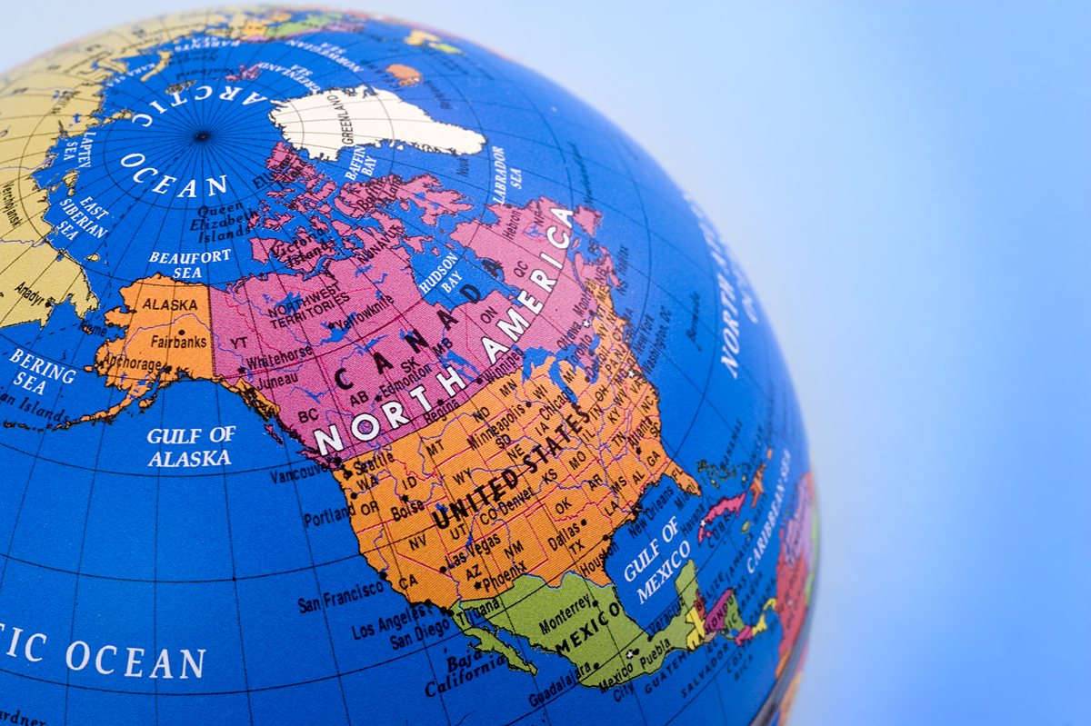
Oh Canada!
Canada’s national and provincial governments provide health care for all citizens.
Broadcasting, transportation, and electric power are heavily regulated. These public services might not have been available in Canada’s remote area without government support.
The Grand Banks, one of the best fishing grounds in the world, is now regulated by the government because of overfishing.
Notes:
The World and Its People, p. 162, The McGraw-Hill Companies, 2005
Government involvement in the economy.

Slide 8
How does Canada answer the
3 Economic Questions?
What to Produce?
  Businesses decide and government approves/denies it
How to produce it?
  Businesses decide & government regulates procedures
For whom to produce?
  Businesses decide based on supply & demand (price)
Which economic system does Canada have?
Market

Slide 9

Republic of Cuba

Slide 10
How does Cuba answer the
3 Economic Questions?
What to Produce?
  Government makes all economic decisions
How to produce it?
  Government decides how to make goods/services
For whom to produce?
  Whoever the government decides to give them to
Which economic system does Cuba have?
Command

Slide 11
Let’s Review!
What are the 4 economic systems? Traditional, Market, and Command
Which Latin American country has a command economy? Cuba
Which two Latin American countries have a market economy? Brazil and Canada
3. Who makes the economic decisions in a command economy? The government
What are the 3 economic questions that every country must answer? What to produce? How to produce? and For whom to produce?
What type of economy do most democratic countries have? Market

